Slide 1






Slide 2
3) LM016L LCD Panel :-
The most commonly used Character based LCDs are based on Hitachi’s HD44780 controller. The operating voltage of the 16 X 2 LCD is 4.7V-5.3V and it consists of 8 Digital pins (D0 to D7). In our project, we use LM016L to display the count of visitors.
.
1) Arduino UNO R3 :-
Arduino Uno is a microcontroller board based on the ATmega328P. It has 14 digital input/output pins, 6 analog inputs, a 16 MHz ceramic resonator, a USB connection, a power jack, an ICSP header and a reset button.

Slide 3
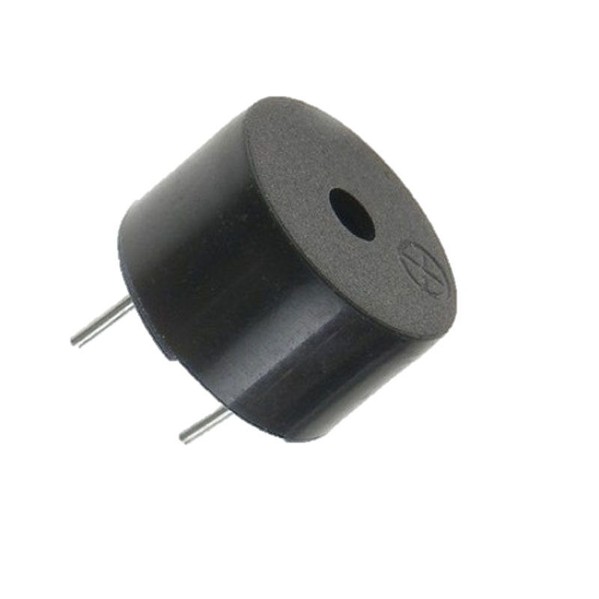
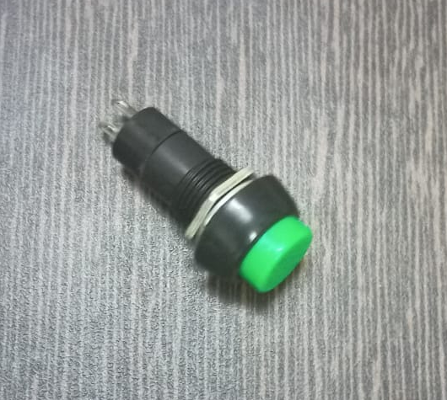
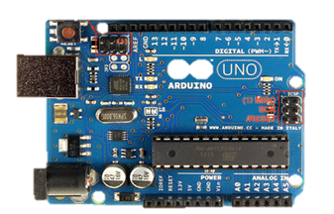
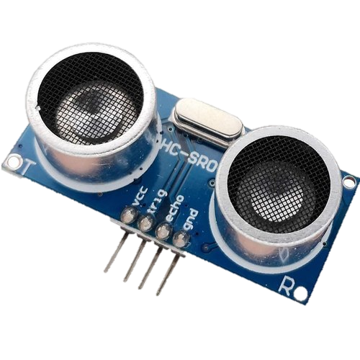
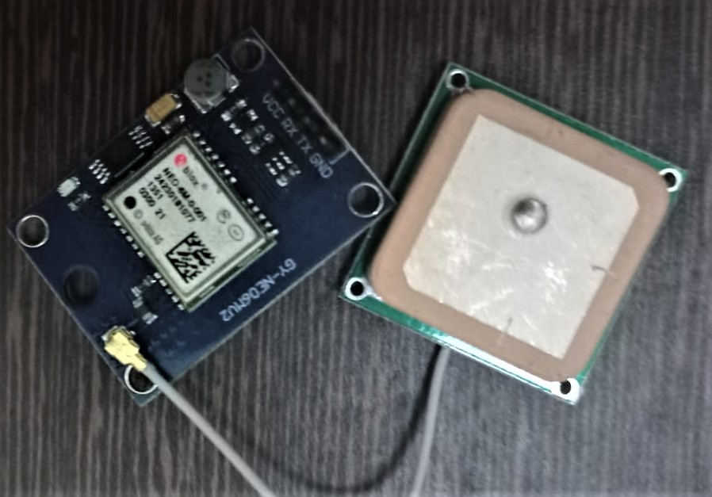
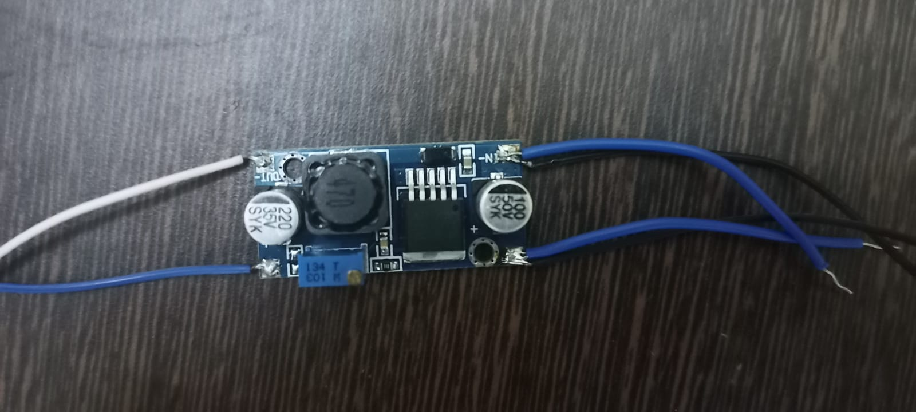
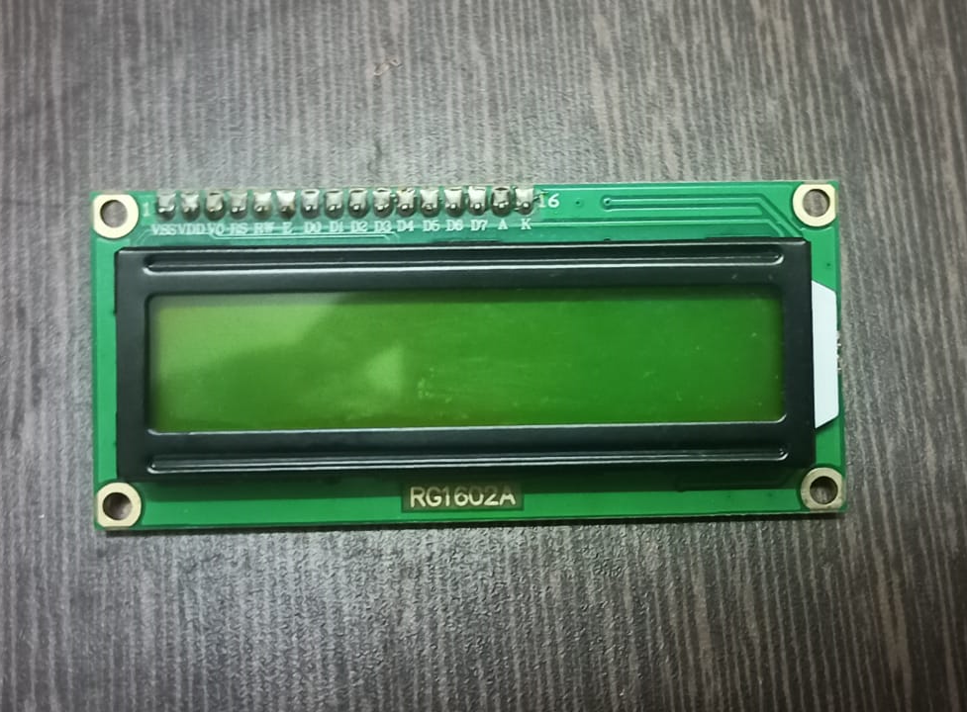
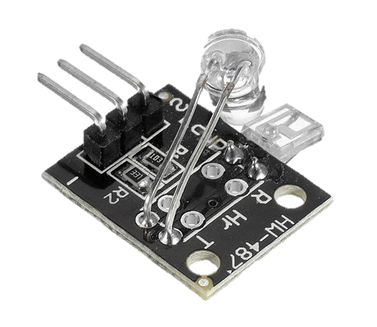
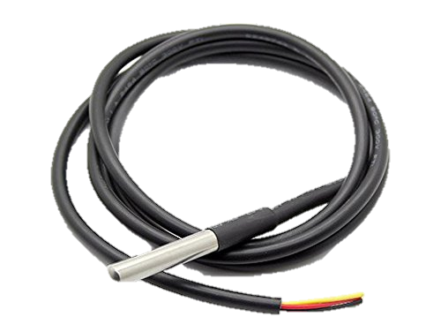
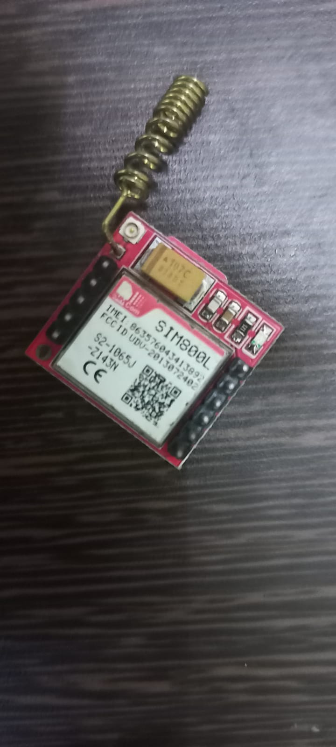
COMPONENTS USED
Push Button
Buzzer
Arduino UNO R3
Neo 6M GPS
Ultrasonic sensor
LM2596 Buck Converter
16x2 LCD Panel
Ky-039 pulse sensor
SIM800l GSM
Temperature sensor

Slide 4
THANKYOU

Slide 5
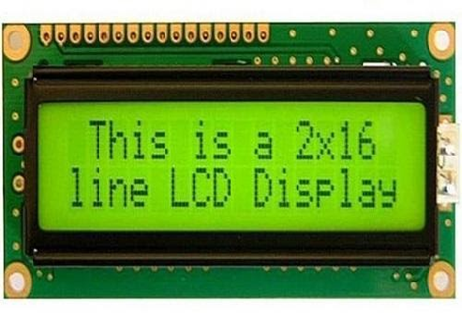
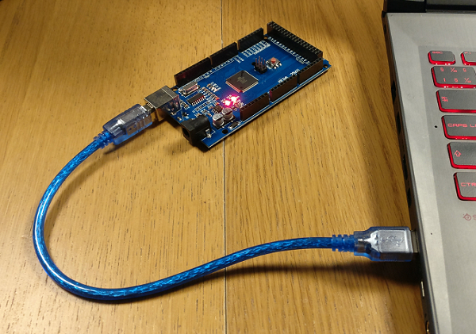
COMPONENTS USED
3) LM016L LCD Panel :-
The most commonly used Character based LCDs are based on Hitachi’s HD44780 controller. The operating voltage of the 16 X 2 LCD is 4.7V-5.3V and it consists of 8 Digital pins (D0 to D7). In our project, we use LM016L to display the count of visitors.
4) Power Supply :-
In our project, since we have used Arduino UNO; the UNO is directly powered by connecting the UNO with the computer using USB Cable.
5) Other basic components like -
LEDs (red & green), jumper cables, resistor and breadboard.

Slide 6
SYSTEM OVERVIEW

Slide 7
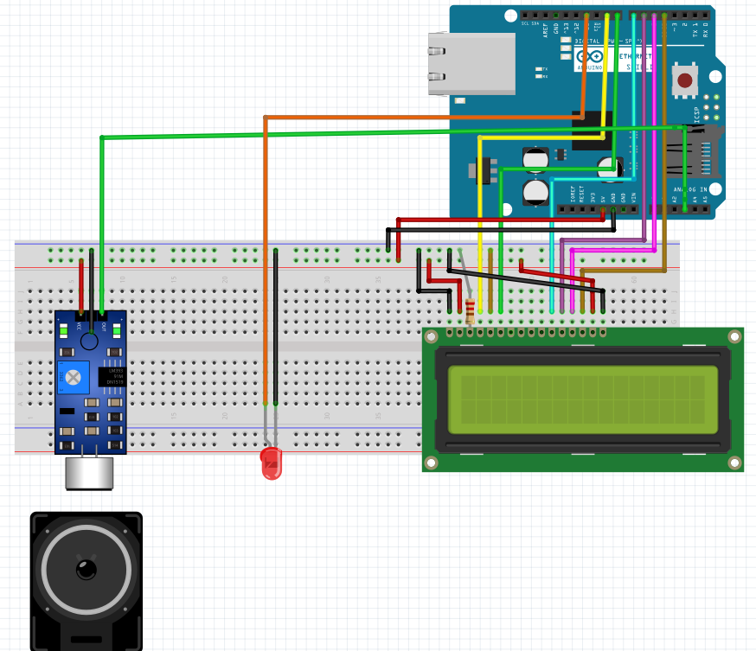
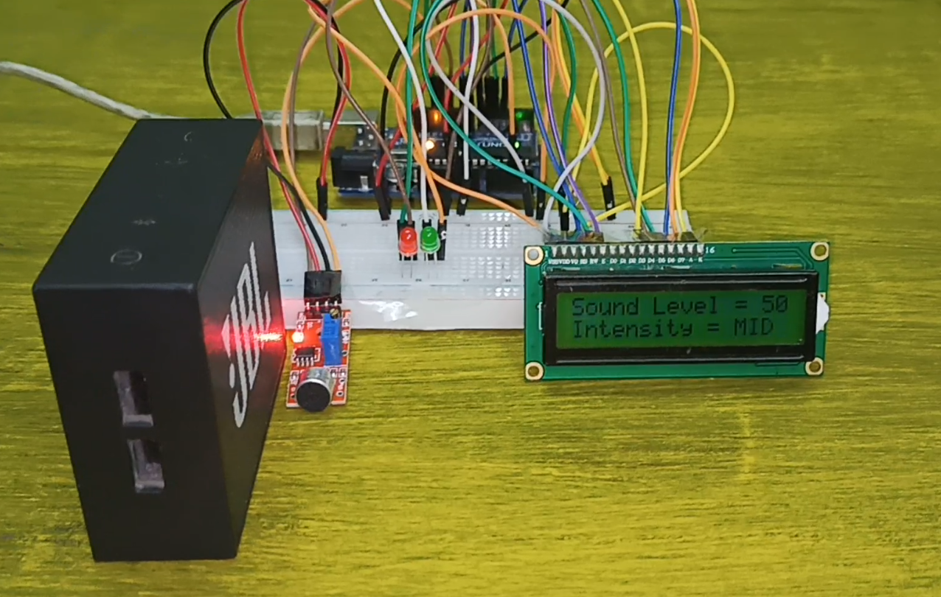
CIRCUIT DIAGRAM

Slide 8
Limitations of our prototype
.
Possible improvements
.

